Slide 1
Line Fitting,
Residuals, and Correlation

Slide 2
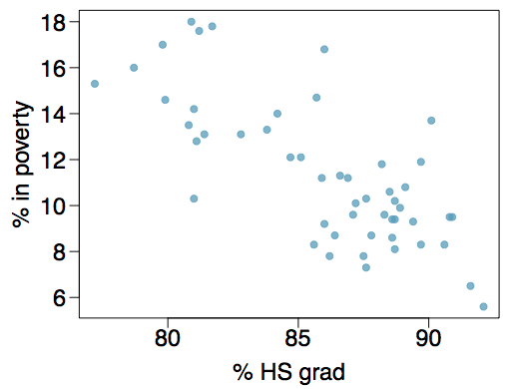
Poverty vs. HS graduate rate
The scatterplot below shows the relationship between HS graduate rate in all 50 US states and DC and the percent of residents who live below the poverty line (income below $23,050 for a family of 4 in 2012).
Response variable?

Slide 3
Poverty vs. HS graduate rate
The scatterplot below shows the relationship between HS graduate rate in all 50 US states and DC and the percent of residents who live below the poverty line (income below $23,050 for a family of 4 in 2012).
Response variable?
% in poverty

Slide 4
Poverty vs. HS graduate rate
The scatterplot below shows the relationship between HS graduate rate in all 50 US states and DC and the percent of residents who live below the poverty line (income below $23,050 for a family of 4 in 2012).
Response variable?
% in poverty
Explanatory variable?

Slide 5
Poverty vs. HS graduate rate
The scatterplot below shows the relationship between HS graduate rate in all 50 US states and DC and the percent of residents who live below the poverty line (income below $23,050 for a family of 4 in 2012).
Response variable?
% in poverty
Explanatory variable?
% HS grad

Slide 6
Poverty vs. HS graduate rate
The scatterplot below shows the relationship between HS graduate rate in all 50 US states and DC and the percent of residents who live below the poverty line (income below $23,050 for a family of 4 in 2012).
Response variable?
% in poverty
Explanatory variable?
% HS grad
Relationship?

Slide 7
Poverty vs. HS graduate rate
The scatterplot below shows the relationship between HS graduate rate in all 50 US states and DC and the percent of residents who live below the poverty line (income below $23,050 for a family of 4 in 2012).
Response variable?
% in poverty
Explanatory variable?
% HS grad
Relationship?
linear, negative, moderately strong

Slide 8
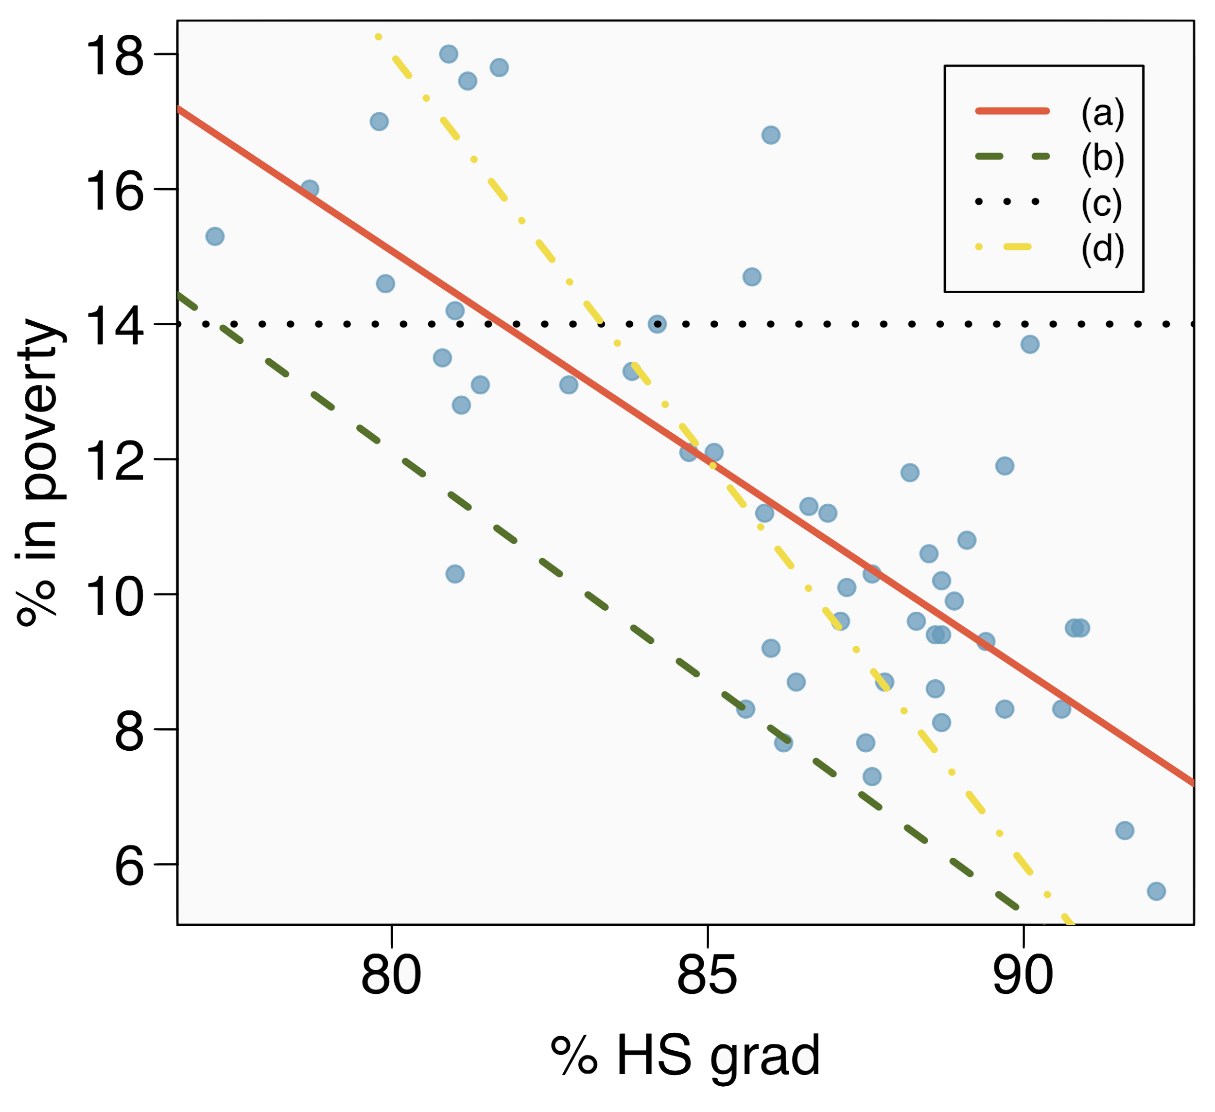
Eyeballing the line
Which of the following appears to be the line that best fits the linear relationship between % in poverty and % HS grad? Choose one.

Slide 9
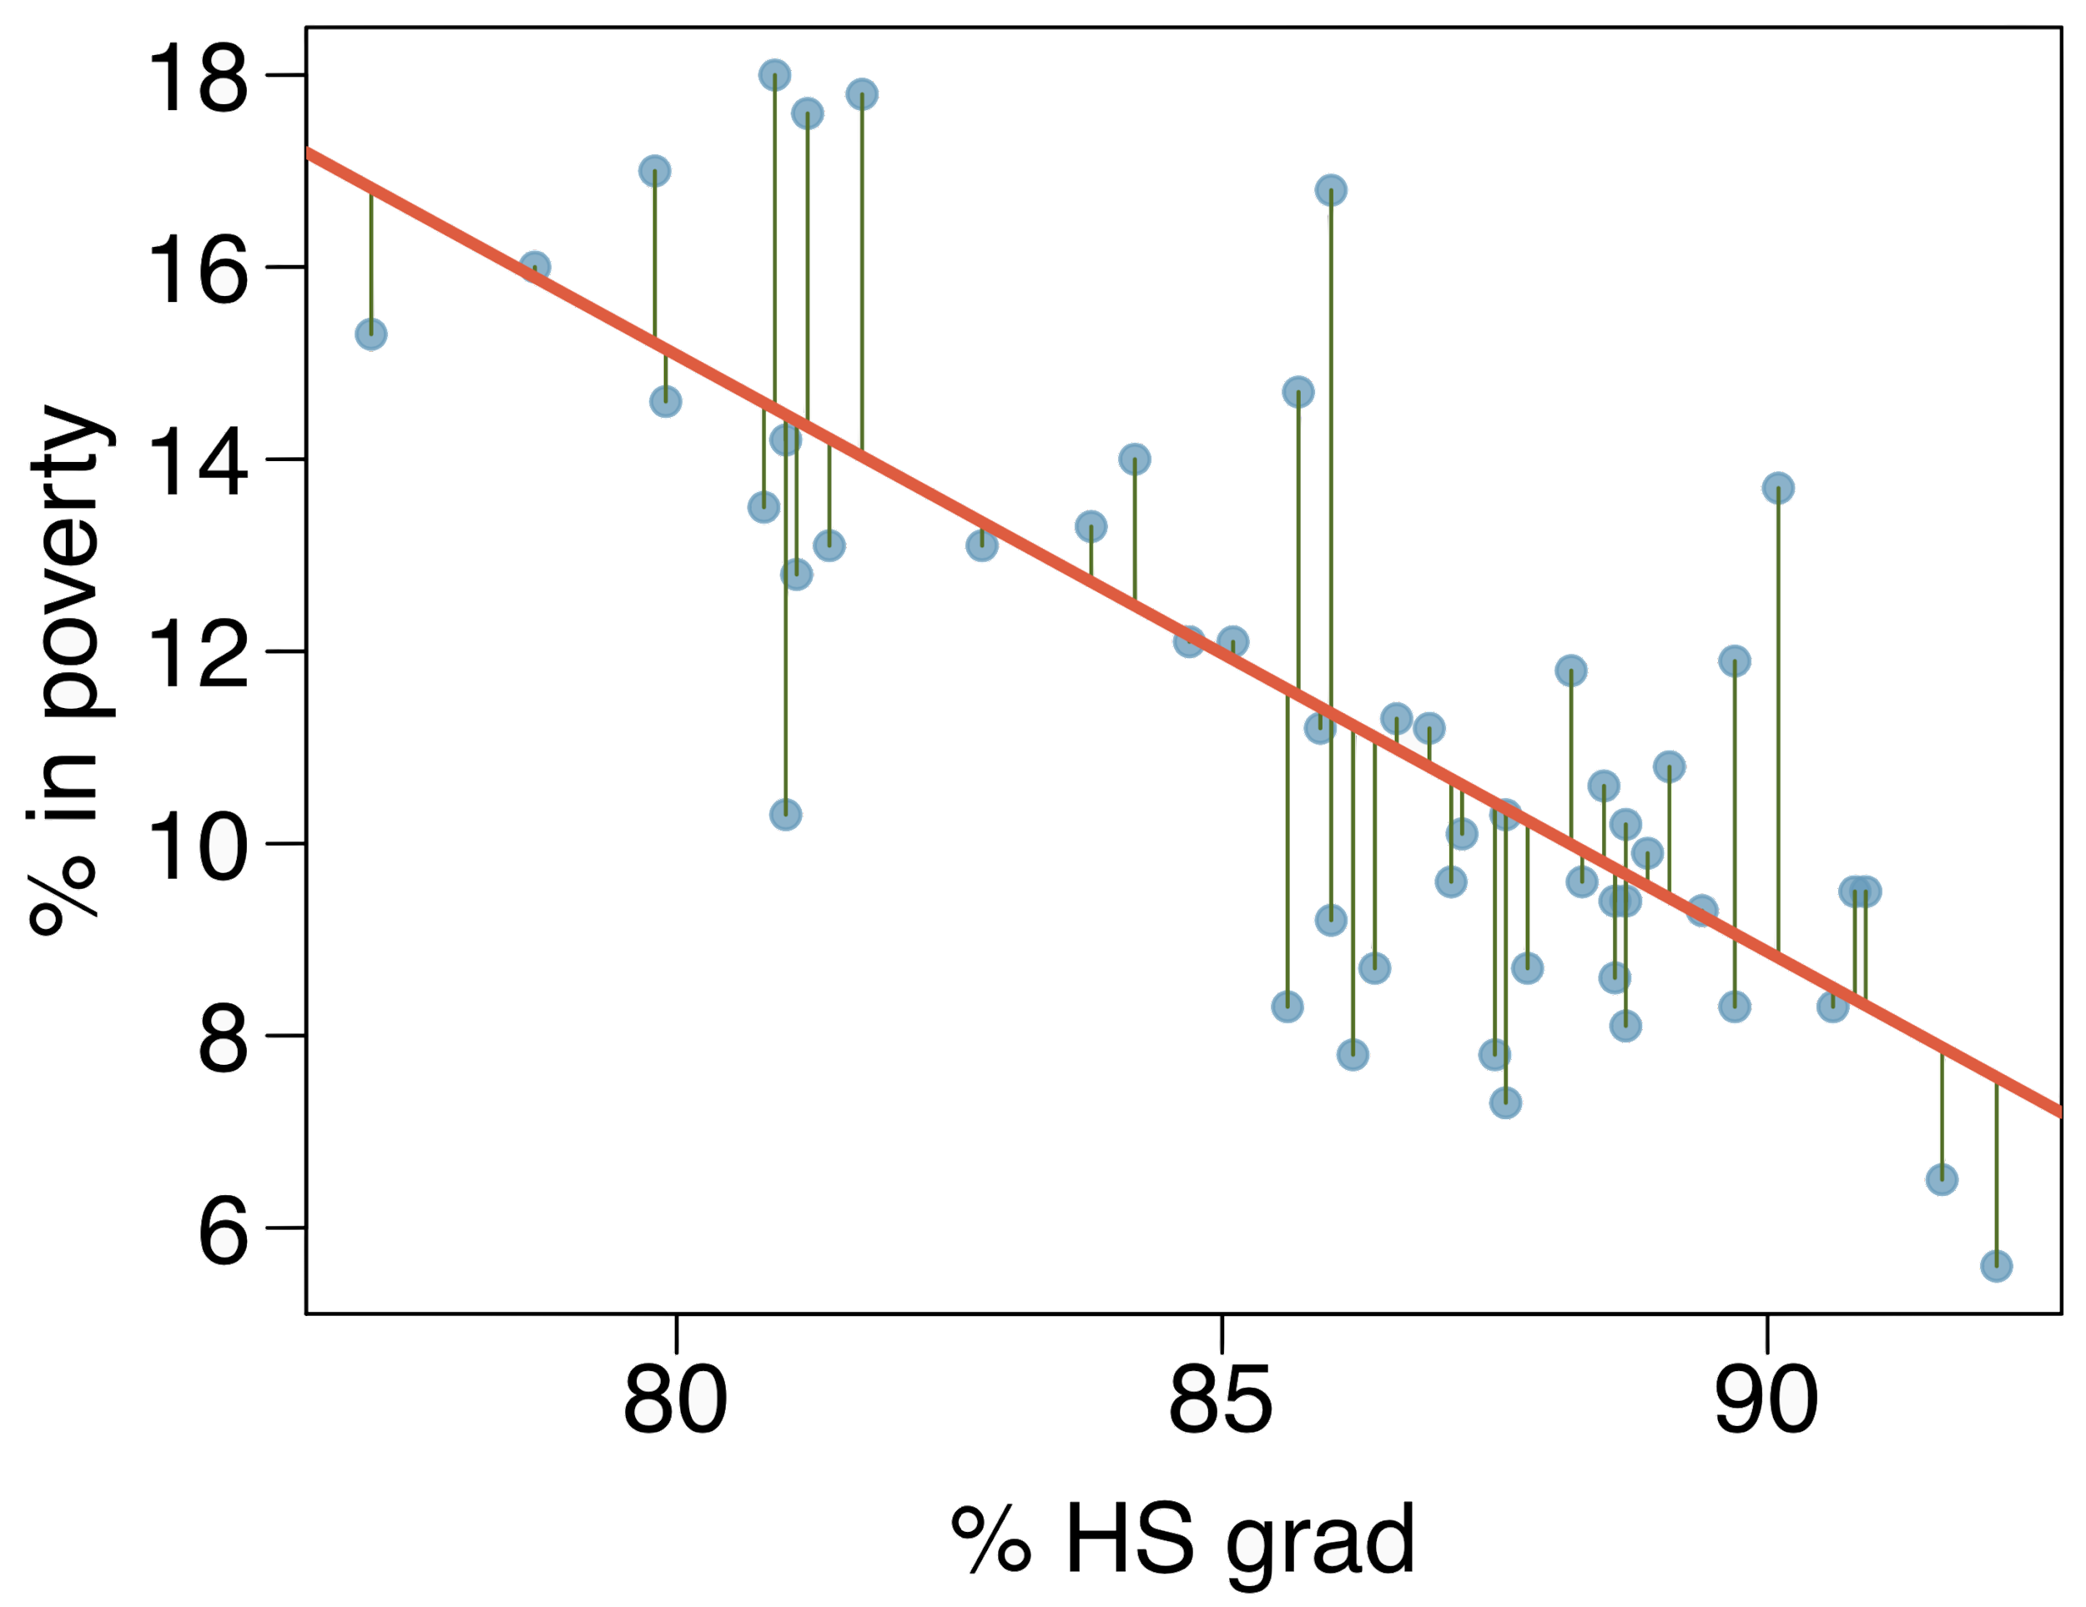
Residuals
Residuals are the leftovers from the model fit:
Data = Fit + Residual

Slide 10
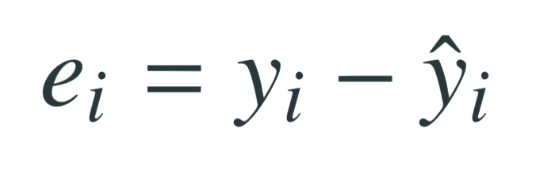
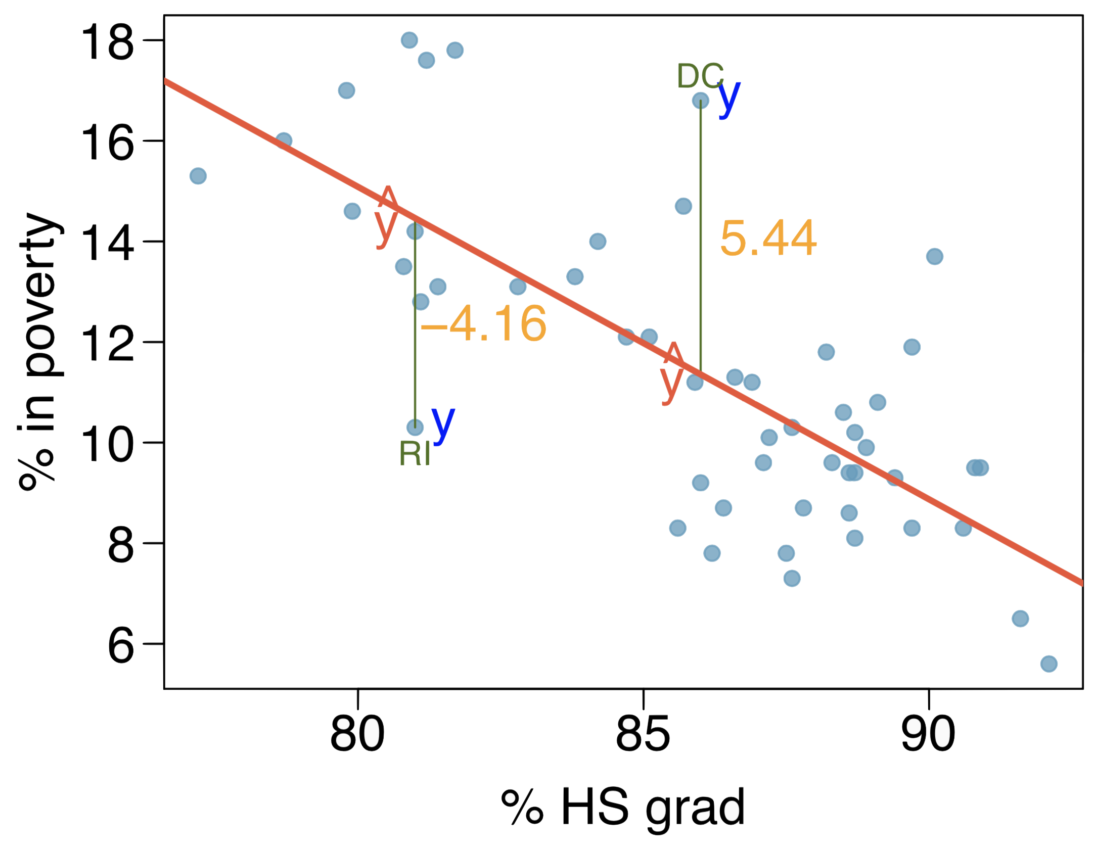
Residuals (cont.)
Residual is the difference between the observed (y_{i}) and predicted ŷ_{i}.

Slide 11
Residuals (cont.)
Residual is the difference between the observed (y_{i}) and predicted ŷ_{i}.
% living in poverty in DC is 5.44% more than predicted.

Slide 12
Residuals (cont.)
Residual is the difference between the observed (y_{i}) and predicted ŷ_{i}.
% living in poverty in DC is 5.44% more than predicted.
% living in poverty in RI is 4.16% less than predicted.

Slide 13
Quantifying the relationship
Correlation describes the strength of the linear association between two variables.

Slide 14
Quantifying the relationship
Correlation describes the strength of the linear relationship between two variables.
It takes values between -1 (perfect negative) and +1 (perfect positive).
A value of 0 indicates no linear association.

Slide 15
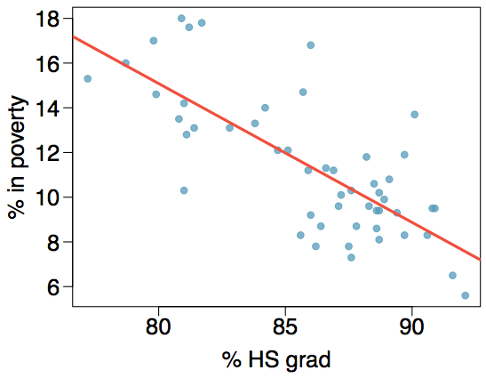
Guessing the correlation
Which of the following is the best guess for the correlation between percent in poverty and percent HS grad?
0.6
-0.75
-0.1
0.02
-1.5

Slide 16
Guessing the correlation
Which of the following is the best guess for the correlation between percent in poverty and percent HS grad?
0.6
-0.75
-0.1
0.02
-1.5

Slide 17
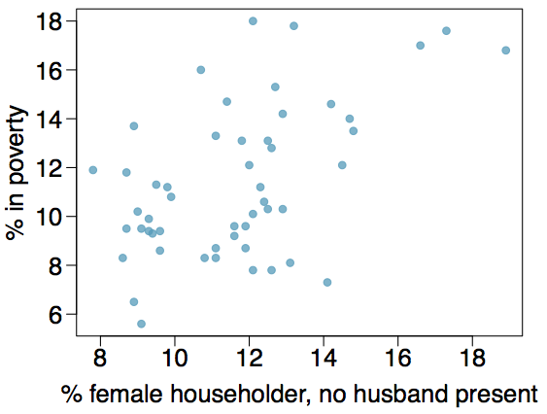
Guessing the correlation
Which of the following is the best guess for the correlation between percent in poverty and percent female householder?
0.1
-0.6
-0.4
0.9
0.5

Slide 18
Guessing the correlation
Which of the following is the best guess for the correlation between percent in poverty and percent female householder?
0.1
-0.6
-0.4
0.9
0.5

Slide 19
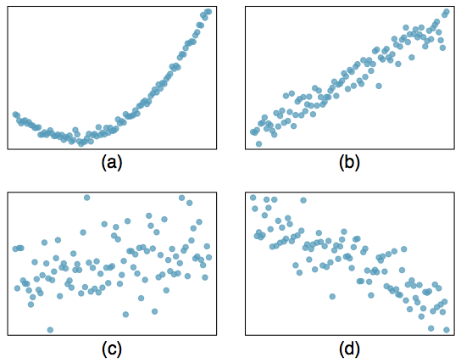
Assessing the correlation
Which of the following is has the strongest correlation, i.e. correlation coefficient closest to +1 or -1?

Slide 20
Assessing the correlation
Which of the following is has the strongest correlation, i.e. correlation coefficient closest to +1 or -1?
(b) → correlation means linear association

